Slide 1
Window-based Stream Data Analytics with SPARK and Kafka
6. Text Classification using Spark
Notes:
‹#›

Slide 2
Learning Outlines
Text Preprocessing by Using Apache Spark
Text Classification by Using Apache Spark
Text Classification Evaluation by Using Apache Spark
Text Stream Classification by Using Apache Spark
Notes:
‹#›

Slide 3
Learning Outlines
Text Preprocessing by Using Apache Spark
Text Classification by Using Apache Spark
Text Classification Evaluation by Using Apache Spark
Text Stream Classification by Using Apache Spark
Notes:
‹#›

Slide 4
Text Classification
Goal: Given a news article documents, predict its topic by using Spark
News Article
Labels
Statistics for first 10 months of 2015 show an 8.6% rise from a year earlier after new North Sea fields were opened Britain’s oil and gas fields have increased production for the first time in more than 15 years, figures show.
Government statistics for the first 10 months of 2015 show oil and gas produced on the UK continental shelf up 8.6% from a year earlier, the industry body Oil & Gas UK said. It added that, based on that number, it expected production for all of 2015 to be between 7% and 8% higher.
0: science
1: Business
2: Sport
3: Politics
4: …

Slide 5
Text Classification: Pipeline
Corpus
Statistics for first 10 months of 2015 show an 8.6% rise from a year earlier after new North Sea fields were opened
Britain’s oil and gas fields have increased production for the first time in more than 15 years, figures show.
Guardian News Articles
Load Textual Data
Extract Features
Train Model
Categories:
Evaluation Metric:
Topics: Business, Sport, Finance, etc
Type of Malware data
Spam or not spam
...
Accuracy
Precision
Recall
F1- measure
Evaluate

Slide 6
Text Classification: Pipeline
Corpus
Statistics for first 10 months of 2015 show an 8.6% rise from a year earlier after new North Sea fields were opened
Britain’s oil and gas fields have increased production for the first time in more than 15 years, figures show.
Guardian News Articles
Load Textual Data
Extract Features
Train Model
Categories:
Evaluation Metric:
Topics: Business, Sport, Finance, etc
Type of Malware data
Spam or not spam
...
Accuracy
Precision
Recall
F1- measure
Evaluate

Slide 7
Text Feature Extraction
The mllib.features package contains several classes for common features transformation.
These includes algorithms to pre-process the text, construct feature vectors from text and ways to to normalize and scale features.

Slide 8
Text Pre-processing: Tokenizer
Tokenization is the process of splitting a text (or s sentence) into individual tokens (usually words).
The example below shows how to split sentences into sequences of words.
from pyspark.ml.feature import Tokenizer sentenceDataFrame = spark.createDataFrame([ (0, "Statistics for first 10 months of 2015 show an 8.6% rise from a year earlier after new North Sea fields were opened Britain’s oil and gas fields have increased production for the first time in more than 15 years, figures show."), (1, "Government statistics for the first 10 months of 2015 show oil and gas produced on the UK continental shelf up 8.6% from a year earlier, the industry body Oil & Gas UK said. It added that, based on that number, it expected production for all of 2015 to be between 7% and 8% higher.") ], ["id", "sentence"])
tokenizer = Tokenizer(inputCol="sentence", outputCol="words")
tokenizer.transform(sentenceDataFrame).show(truncate=False)

Slide 9
Text Pre-processing: Stop Words Remover
Stop words are words which should be excluded from the input, typically because the words appear frequently and don’t carry as much meaning.
The example below shows the output of the stop words remover.
id | raw | filtered
0 | [Statistics, for, first, 10, months, of, 2015, show, an, 8.6%, rise, from, a, year, earlier] | [Statistics, first, 10, months, 2015, show, 8.6%, rise, year, earlier]
1 | [Government, statistics, for, the, first, 10, months, of, 2015] | [Government, statistics, first, 10, months, 2015]

Slide 10
Text Pre-processing: Stop Words Remover
StopWordsRemover takes as input a sequence of strings (e.g. the output of a Tokenizer) and drops all the stop words from the input sequences.
from pyspark.ml.feature import StopWordsRemover sentenceData = spark.createDataFrame([ (0, ["Statistics", "for", "first", "10", "months", "of", "2015", "show", "an", "8.6%", "rise", "from", "a", "year", "earlier"]), (1, ["Government", "statistics", "for", "the", "first", "10", "months", "of", "2015"]) ], ["id", "raw"]) remover = StopWordsRemover(inputCol="raw", outputCol="filtered") remover.transform(sentenceData).show(truncate=False)

Slide 11
Text Pre-processing: n-gram
An n-gram is a sequence of n tokens (typically words) for some integer n.
NGram takes as input a sequence of strings (e.g. the output of a Tokenizer or StopWordRemover).
The parameter n is used to determine the number of terms in each n-gram.
from pyspark.ml.feature import NGram wordDataFrame = spark.createDataFrame([ (0, ["Statistics", "for", "first", "10", "months", "of", "2015", "show", "an", "8.6%", "rise", "from", "a", "year", "earlier"]), (1, ["Government", "statistics", "for", "the", "first", "10", "months", "of", "2015"]) ], ["id", "words"])
ngram = NGram(n=2, inputCol="words", outputCol="ngrams") ngramDataFrame = ngram.transform(wordDataFrame) ngramDataFrame.select("ngrams").show(truncate=False)

Slide 12
Feature Extraction: TF-IDF
TF-IDF is a feature vectorization method widely used in text classification to reflect the importance of a term to a document in the corpus.
TF: Both HashingTF and CountVectorizer can be used to generate the term frequency vectors.
IDF: IDF is an Estimator which is fit on a dataset and produces an IDFModel. The IDFModel takes feature vectors (generally created from HashingTF or CountVectorizer) and scales each feature.

Slide 13
Feature Extraction: TF-IDF
from pyspark.ml.feature import HashingTF, IDF wordsData = spark.createDataFrame([ (1.0, ["Statistics", "for", "first", "10", "months", "of", "2015", "show", "an", "8.6%", "rise", "from", "a", "year", "earlier"]), (1.0, ["Government", "statistics", "for", "the", "first", "10", "months", "of", "2015"]) ], ["label", "words"])
hashingTF = HashingTF(inputCol="words", outputCol="rawFeatures", numFeatures=20) featurizedData = hashingTF.transform(wordsData)
idf = IDF(inputCol="rawFeatures", outputCol="features") idfModel = idf.fit(featurizedData) rescaledData = idfModel.transform(featurizedData) rescaledData.select("label", "features").show()

Slide 14
Feature Extraction: Word2Vec
Word2Vec is an Estimator which takes sequences of words representing documents and trains a Word2VecModel.
The model maps each word to a unique fixed-size vector. The Word2VecModel transforms each document into a vector using the average of all words in the document.

Slide 15
Feature Extraction: Word2Vec
from pyspark.ml.feature import Word2Vec # Input data: Each row is a bag of words from a sentence or document. documentDF = spark.createDataFrame([ ("Statistics for first 10 months of 2015 show an 8.6% rise from a year earlier".split(" "), ), ("Government statistics for the first 10 months of 2015".split(" "), ), ], ["text"]) # Learn a mapping from words to Vectors. word2Vec = Word2Vec(vectorSize=3, minCount=0, inputCol="text", outputCol="result") model = word2Vec.fit(documentDF)
# Show the result for each sentence
result = model.transform(documentDF) for row in result.collect(): text, vector = row print("Text: [%s] => \nVector: %s\n" % (", ".join(text), str(vector)))

Slide 16
Learning Outlines
Text Preprocessing by Using Apache Spark
Text Classification by Using Apache Spark
Text Classification Evaluation by Using Apache Spark
Text Stream Classification by Using Apache Spark
Notes:
‹#›

Slide 17
Text Classification: Pipeline
Corpus
Statistics for first 10 months of 2015 show an 8.6% rise from a year earlier after new North Sea fields were opened
Britain’s oil and gas fields have increased production for the first time in more than 15 years, figures show.
Guardian News Articles
Load Textual Data
Extract Features
Train Model
Categories:
Evaluation Metric:
Topics: Business, Sport, Finance, etc
Type of Malware data
Spam or not spam
...
Accuracy
Precision
Recall
F1- measure
Evaluate

Slide 18
Text Classification
MLlib is a Spark’s library of machine learning functions including classification algorithms, such as:
Naïve Bayes
Decision Tree
SVM
Random Forest
logistic regression

Slide 19
Text Classification
Input:
LabelCol
Labels: Categories of text, type of anomalies, topic of news, etc.
Type: Double
Default name: “label”
featureCol:
Feature vector: TF-IDF, Word2vec, etc.
Type: Vector
Default: “features”
Example:
(1.0, [1.3, 24.2, 3.5, 21.0, 4.4, 5.7]), (3.0, [4.6, 94.5, 2.5, 31.5, 3.1, 7.2]), (2.0, [2.1, 58.5, 1.3, 29.1, 6.8, 8.4])

Slide 20
Text Classification
After extracting features from text data, we need to convert the vector from the following input format to the LabeledPoint format.
Input example: (label, fea1, fea2, ...)
(1.0, 1.3, 24.2, 3.5, 21.0, 4.4, 5.7), (3.0, 4.6, 94.5, 2.5, 31.5, 3.1, 7.2), (2.0, 2.1, 58.5, 1.3, 29.1, 6.8, 8.4)
LabeledPoint format: (label, [fea1, fea2, … )
(1.0, [1.3, 24.2, 3.5, 21.0, 4.4, 5.7]), (3.0, [4.6, 94.5, 2.5, 31.5, 3.1, 7.2]), (2.0, [2.1, 58.5, 1.3, 29.1, 6.8, 8.4])
from pyspark.ml.regression import LabeledPoint
#parse data
def parsePoint(line):
values = [float(x) for x in line.split(‘,’)
return LabeledPoint(Values[0], values[1:])

Slide 21
Text Classification: Naïve Bayes
from pyspark.ml.classification import NaiveBayes from pyspark.ml.evaluation import MulticlassClassificationEvaluator
# Load the data
sc = SparkContext(appName = “NBayes”)
data = sc.textFile("data/guardian.txt") # Split the data into training and test sets (30% held out for testing) (trainingData, testData) = data.randomSplit([0.7, 0.3]) # create the trainer and set its parameters nb = NaiveBayes(smoothing=1.0, modelType="multinomial") # train the model model = nb.fit(trainingData) # Apply the model on the testData predictions = model.transform(testData) # compute accuracy on the test set evaluator = MulticlassClassificationEvaluator(labelCol="label", predictionCol="prediction", metricName="accuracy") accuracy = evaluator.evaluate(predictions) print("Test set accuracy = " + str(accuracy))

Slide 22
Text Classification: Decision tree
from pyspark.mllib.tree import DecisionTree, DecisionTreeModel from pyspark.mllib.util import MulticlassClassificationEvaluator
# Load the data
sc = SparkContext(appName = “Decision Tree”)
data = sc.textFile("data/guardian.txt") # Split the data into training and test sets (30% held out for testing) (trainingData, testData) = data.randomSplit([0.7, 0.3]) # Train a DecisionTree model. # Empty categoricalFeaturesInfo indicates all features are continuous. model = DecisionTree.trainClassifier(trainingData, numClasses=2, categoricalFeaturesInfo={}, impurity='gini', maxDepth=5, maxBins=32)
# Apply the model on the testData predictions = model.transform(testData) # compute accuracy on the test set evaluator = MulticlassClassificationEvaluator(labelCol="label", predictionCol="prediction", metricName="accuracy") accuracy = evaluator.evaluate(predictions) print("Test set accuracy = " + str(accuracy))

Slide 23
Text Classification: Linear Support Vector Machines (SVMs)
from pyspark.mllib.classification import LinearSVC from pyspark.mllib.util import MulticlassClassificationEvaluator
# Load the data
sc = SparkContext(appName = “SVM”)
data = sc.textFile("data/guardian.txt") parsedData = data.map(parsePoint) # Split the data into training and test sets (30% held out for testing) (trainingData, testData) = data.randomSplit([0.7, 0.3]) # Train the model. lsvc = LinearSVC(maxIter=100, regParam=0.1) lsvcModel = lsvc.fit(trainingData)

Slide 24
Learning Outlines
Text Preprocessing by Using Apache Spark
Text Classification by Using Apache Spark
Text Classification Evaluation by Using Apache Spark
Text Stream Classification by Using Apache Spark
Notes:
‹#›

Slide 25
Text Classification: Pipeline
Corpus
Statistics for first 10 months of 2015 show an 8.6% rise from a year earlier after new North Sea fields were opened
Britain’s oil and gas fields have increased production for the first time in more than 15 years, figures show.
Guardian News Articles
Load Textual Data
Extract Features
Train Model
Categories:
Evaluation Metric:
Topics: Business, Sport, Finance, etc
Type of Malware data
Spam or not spam
...
Accuracy
Precision
Recall
F1- measure
Evaluate

Slide 26
Classification Evaluation
Currently, spark.ml supports model selection using the CrossValidator class, which takes an Estimator, a set of ParamMaps, and an Evaluator
– CrossValidator begins by splitting the dataset into a set of folds which are used as separate training and test datasets
e.g., with k=3 folds, CrossValidator will generate 3 (training, test) dataset pairs, each of which uses 2/3 of the data for training and 1/3 for testing
– CrossValidator iterates through the set of ParamMaps
– For each ParamMap, it trains the given Estimator and evaluates it using the given Evaluator

Slide 27
Classification Evaluation: CrossValidator
from pyspark.ml import Pipeline from pyspark.ml.classification import LogisticRegression from pyspark.ml.feature import HashingTF, Tokenizer from pyspark.ml.tuning import CrossValidator, ParamGridBuilder
# Configure an ML pipeline, which consists of tree stages: tokenizer, hashingTF, and lr. tokenizer = Tokenizer(inputCol="text", outputCol="words") hashingTF = HashingTF(inputCol=tokenizer.getOutputCol(), outputCol="features") lr = LogisticRegression(maxIter=10) pipeline = Pipeline(stages=[tokenizer, hashingTF, lr])
# A CrossValidator requires an Estimator, a set of Estimator ParamMaps, and an Evaluator.
#ParamGridBuilder to construct a grid of parameters to search over. # With 3 values for hashingTF.numFeatures and 2 values for lr.regParam
paramGrid = ParamGridBuilder() \ .addGrid(hashingTF.numFeatures, [10, 100, 1000]) \ .addGrid(lr.regParam, [0.1, 0.01]) \ .build()
crossval = CrossValidator(estimator=pipeline, estimatorParamMaps=paramGrid, evaluator=BinaryClassificationEvaluator(), numFolds=2) # use 3+ folds in practice # Run cross-validation, and choose the best set of parameters. cvModel = crossval.fit(training)

Slide 28
Learning Outlines
Text Preprocessing by Using Apache Spark
Text Classification by Using Apache Spark
Text Classification Evaluation by Using Apache Spark
Text Stream Classification by Using Apache Spark
Notes:
‹#›

Slide 29
Spark Streaming
Problem:
Let’s assume we need to categorize the stream of news articles to predefined news topics (labels). We can capture the news articles through Guardian API, then we will pass it to the text processing pipeline to label them by using Apache Kafka as a producer.
Step 1: Train and save an offline pipeline for text preprocessing, feature extraction and classification by using am offline training data.
Notes:
‹#›

Slide 30
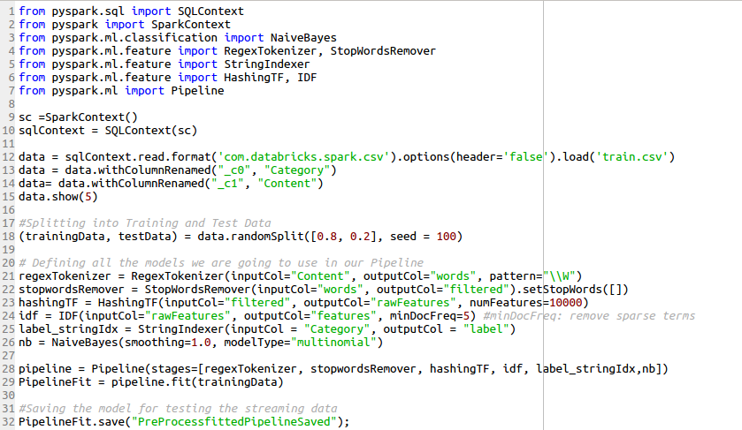
Spark Streaming
Loading the data
Tokenize the text into words
Remove Stopwords
Calculate Term Frequency
Find out Inverse Doc Frequency
String label to Integer
NaiveBayes Classifier
Build a pipeline with all the stages defined above
Train the model
Save the model
Notes:
‹#›

Slide 31
Spark Streaming
Step 2: Run the Apache Kafka and ZooKeeper, then create a topic (see Kafka setup tutorial)
Step 3: We need to create SparkContext with n (number of) working thread and then we define the batch interval as t seconds.
Here, we are receiving data through Kafka. Then, give its parameters as an input of the program.
$ 'spark-submit --packages org.apache.spark:spark-streaming-kafka-0-8_2.11:2.0.1 App_Name.py.py localhost:port <topic>
Let assume the input stream has the “Category||News Article Text” format.
Notes:
‹#›

Slide 32
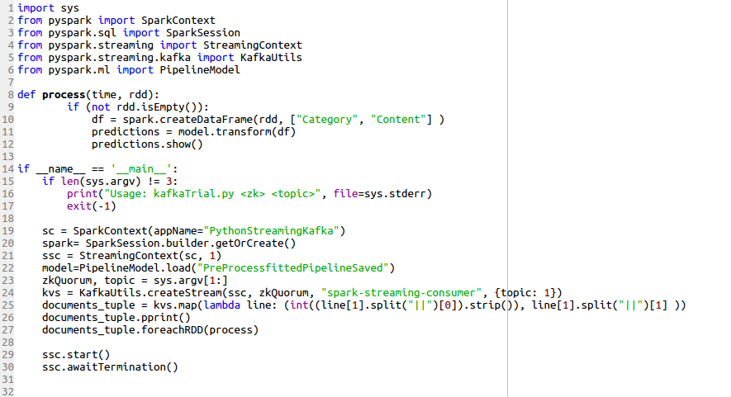
Spark Streaming
Notes:
‹#›

Slide 33
References
Apache Spark online documentation:
https://spark.apache.org/docs/2.1.0/ml-features.html
http://spark.apache.org/docs/2.1.0/api/python/index.html
Apache Kafka:
https://kafka.apache.org/quickstart
Notes:
‹#›

